Slide 1



Producer Price Indeces
Revised methodology
Presentation to the ESS Team leaders – May 2021
Michele Vollaro – Economic Statistics Team
Author, date, venue

Slide 2
Producer Price Indexes – Revised methodology
The Agricultural Producer Price dataset
Prices received by farmers at the farm-gate or at the first point of sale – as defined in SNA 2008
Annual data for 161 Countries and 262 Items in 2020
gathered through questionnaires
The indices measure the average annual change over time of agricultural producer prices
Three categories of producer price indices (PPI):
Single-item price indices
Commodity group indices
Agriculture producer price index.

Slide 3
Producer Price Indexes – Revised methodology
Workflow of the Agricultural Producer Prices
Data processing and entry:
Harvested questionnaires of Agricultural Producer Prices
Conversion of currencies and Units of measure
Data checks (outliers detection and imputation):
Checking for consistency of data
Outlier detection and correction
Imputation of data gaps
Data validation and dissemination:
Validation of integrated dataset: official plus imputed data
Calculation of PPIs
Forecast of t-1 PPI values
Dissemination
Release of 2020 PPIs anticipated to December 2021

Slide 4
Producer Price Indexes – Revised methodology
Migration of the Producer Prices dataset into SWS
November 2020
migration process of Producer Prices started
December 2020
no technical issues encountered
dataset disseminated
February 2021
conclusion of new imputation approach carried out outside the SWS (started in September)
integration of imputed data into dataset
calculation of PPI into SWS
March 2021
verification and validation
emergence of a critical bug into the SWS software: not able to import the history of data modifications (after several trials)
PP data not validated - wrong PP data into SWS
Restart of integration, calculation of PPI and validation steps into IS

Slide 5
Producer Price Indexes – Revised methodology
Notes:
After an increase from 2018 to 2019 in all regions, in 2020 we observe a reduction in Africa (NA: Algeria; SSA: Benin, Ethiopia, Mozambique, Namibia, Sao Tome Prn, Sierra Leone) and Americas (Barbados El Salvador Panama Saint Vincent/Grenadines Trinidad Tobago), while an increase in Asia (CA: Kyrgyzstan, Tajikistan; EA: China, SEA: Myanmar; SA: Afghanistan; WA: Bahrain, Iraq, Qatar).

Slide 6
Producer Price Indexes – Revised methodology
Agricultural Producer Prices – Response rate
Regions | 2017 | 2018 | 2019 | 2020 | Sub Regions
Africa | 35.2 | 33.3 | 40.7 | 37.0
 | 83.3 | 50.0 | 50.0 | 33.3 | Northern Africa
 | 29.2 | 31.3 | 39.6 | 37.5 | Sub-Saharan Africa
Americas | 63.9 | 55.6 | 61.1 | 52.8
 | 61.8 | 52.9 | 58.8 | 50.0 | Latin America and the Caribbean
 | 100.0 | 100.0 | 100.0 | 100.0 | Northern America
Asia | 63.3 | 69.4 | 61.2 | 75.5
 | 40.0 | 60.0 | 20.0 | 60.0 | Central Asia
 | 50.0 | 66.7 | 66.7 | 83.3 | Eastern Asia
 | 72.7 | 72.7 | 63.6 | 72.7 | South-eastern Asia
 | 77.8 | 66.7 | 55.6 | 66.7 | Southern Asia
 | 61.1 | 72.2 | 72.2 | 83.3 | Western Asia
Europe | 94.9 | 94.9 | 97.4 | 97.4
 | 90.0 | 90.0 | 100.0 | 100.0 | Eastern Europe
 | 100.0 | 100.0 | 100.0 | 100.0 | Northern Europe
 | 91.7 | 91.7 | 91.7 | 91.7 | Southern Europe
 | 100.0 | 100.0 | 100.0 | 100.0 | Western Europe
Oceania | 27.3 | 36.4 | 45.5 | 45.5
 | 100.0 | 100.0 | 100.0 | 100.0 | Australia and New Zealand
 | 0.0 | 40.0 | 40.0 | 40.0 | Melanesia
 | 25.0 | 0.0 | 25.0 | 25.0 | Polynesia
World | 59.79 | 59.79 | 61.90 | 62.96
Notes:
After an increase from 2018 to 2019 in all regions, in 2020 we observe a reduction in Africa (NA: Algeria; SSA: Benin, Ethiopia, Mozambique, Namibia, Sao Tome Prn, Sierra Leone) and Americas (Barbados El Salvador Panama Saint Vincent/Grenadines Trinidad Tobago), while an increase in Asia (CA: Kyrgyzstan, Tajikistan; EA: China, SEA: Myanmar; SA: Afghanistan; WA: Bahrain, Iraq, Qatar).

Slide 7
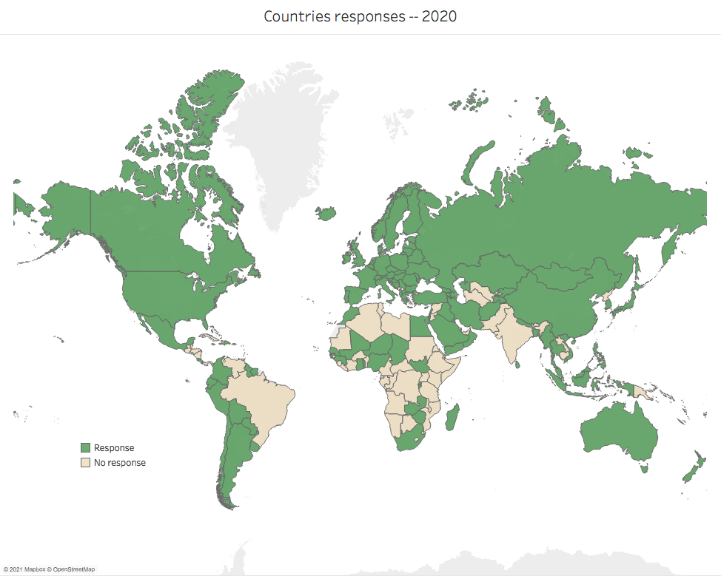
Producer Price Indexes – Revised methodology
Notes:
After an increase from 2018 to 2019 in all regions, in 2020 we observe a reduction in Africa (NA: Algeria; SSA: Benin, Ethiopia, Mozambique, Namibia, Sao Tome Prn, Sierra Leone) and Americas (Barbados El Salvador Panama Saint Vincent/Grenadines Trinidad Tobago), while an increase in Asia (CA: Kyrgyzstan, Tajikistan; EA: China, SEA: Myanmar; SA: Afghanistan; WA: Bahrain, Iraq, Qatar).

Slide 8
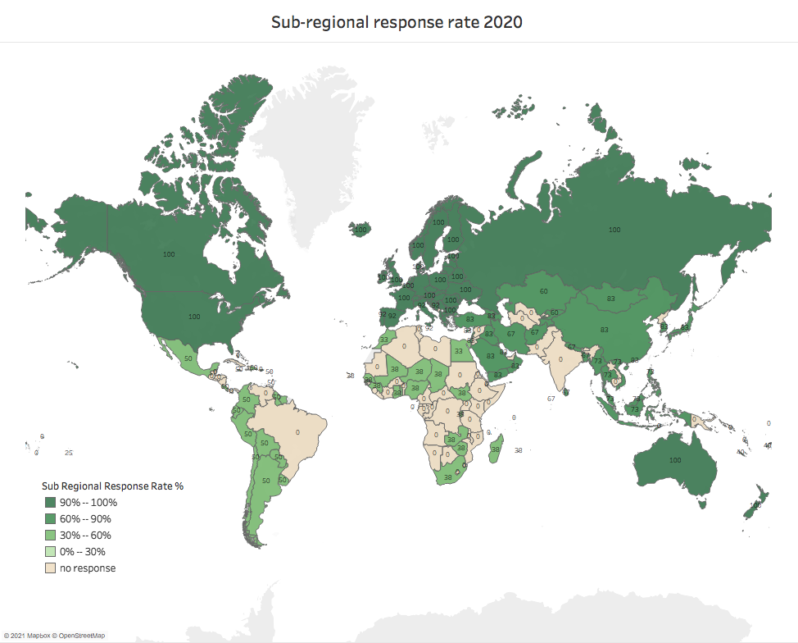
Producer Price Indexes – Revised methodology
Notes:
After an increase from 2018 to 2019 in all regions, in 2020 we observe a reduction in Africa (NA: Algeria; SSA: Benin, Ethiopia, Mozambique, Namibia, Sao Tome Prn, Sierra Leone) and Americas (Barbados El Salvador Panama Saint Vincent/Grenadines Trinidad Tobago), while an increase in Asia (CA: Kyrgyzstan, Tajikistan; EA: China, SEA: Myanmar; SA: Afghanistan; WA: Bahrain, Iraq, Qatar).

Slide 9
Producer Price Indexes – Revised methodology
Notes:
After an increase from 2018 to 2019 in all regions, in 2020 we observe a reduction in Africa (NA: Algeria; SSA: Benin, Ethiopia, Mozambique, Namibia, Sao Tome Prn, Sierra Leone) and Americas (Barbados El Salvador Panama Saint Vincent/Grenadines Trinidad Tobago), while an increase in Asia (CA: Kyrgyzstan, Tajikistan; EA: China, SEA: Myanmar; SA: Afghanistan; WA: Bahrain, Iraq, Qatar).

Slide 10
Producer Price Indexes – Revised methodology
Agricultural Producer Prices – Completeness rate
Regions | 2017 | 2018 | 2019 | Sub Regions
Africa | 24.7 | 22.4 | 11.7
 | 29.0 | 28.8 | 8.1 | Northern Africa
 | 23.6 | 20.8 | 12.6 | Sub-Saharan Africa
Americas | 40.4 | 36.2 | 29.5
 | 38.1 | 33.7 | 26.9 | Latin America and the Caribbean
 | 64.5 | 62.2 | 58.1 | Northern America
Asia | 44.4 | 40.5 | 37.8
 | 33.8 | 30.6 | 30.6 | Central Asia
 | 30.5 | 32.0 | 33.4 | Eastern Asia
 | 37.0 | 36.3 | 32.6 | South-eastern Asia
 | 35.3 | 26.5 | 25.1 | Southern Asia
 | 63.6 | 58.0 | 52.4 | Western Asia
Europe | 50.9 | 50.6 | 48.2
 | 47.9 | 47.6 | 47.3 | Eastern Europe
 | 45.7 | 45.3 | 43.9 | Northern Europe
 | 53.3 | 53.0 | 48.7 | Southern Europe
 | 56.7 | 56.5 | 53.1 | Western Europe
Oceania | 34.2 | 34.8 | 31.0
 | 25.1 | 25.6 | 25.1 | Australia and New Zealand
 | 59.6 | 60.6 | 57.7 | Melanesia
 | 20.4 | 20.4 |  | Polynesia
World | 40.93 | 38.42 | 33.33
Notes:
Generalized reduction of official data since 2017, with the exception of Oceania in 2018 and Eastern Asia in 2019.

Slide 11
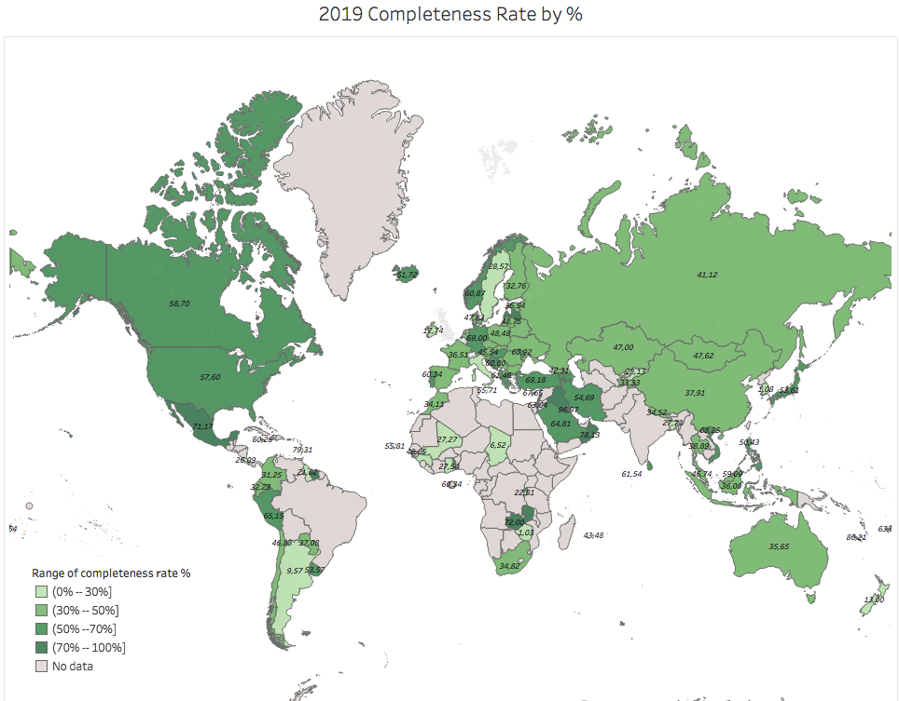
Producer Price Indexes – Revised methodology
Notes:
After an increase from 2018 to 2019 in all regions, in 2020 we observe a reduction in Africa (NA: Algeria; SSA: Benin, Ethiopia, Mozambique, Namibia, Sao Tome Prn, Sierra Leone) and Americas (Barbados El Salvador Panama Saint Vincent/Grenadines Trinidad Tobago), while an increase in Asia (CA: Kyrgyzstan, Tajikistan; EA: China, SEA: Myanmar; SA: Afghanistan; WA: Bahrain, Iraq, Qatar).

Slide 12
Producer Price Indexes – Revised methodology
Why do we need imputation and forecasts?
Apparently – many missing values
However – unable to distinguish between
Missing value: M – Item cannot exist
Missing value: O – Item is missing due to several reasons
So – Imputation applied only to gaps in PP series
New methodology based on Autoregressive (AR)-Integrated (I)-Moving Average (MA) models: ARIMA
Prices collected for period t-2 wrt release in period t
Robust forecast of t-1 values using Holt-Winters (HW) method
 | 2015 | 2016 | 2017 | 2018 | 2019 | 1991-2019
Total | 13,246 | 13,246 | 13,246 | 13,246 | 13,246 | 384,134
Official | 5,331 | 5,301 | 5,284 | 4,960 | 4,302 | 52,579
Missing | 7,915 | 7,945 | 7,962 | 8,286 | 8,944 | 331,555
Official | 40% | 40% | 40% | 37% | 32% | 14%
Missing | 60% | 60% | 60% | 63% | 68% | 86%

Slide 13
Producer Price Indexes – Revised methodology
Previous imputation methodology
Still applied
Application of
price changes of a similar commodity to follow the same trend, (e.g. prices of main cereal products are used to estimate missing cereal prices);
country’s PPI (Producer Price Index) to estimate current values;
another price indicator (e.g. CPI, GDP deflator);
price ratio between commodities, or price ratio of neighbouring countries (e.g., using ratio of millet in Turkey to estimate prices in other countries)
Extrapolation based on annual changes

Slide 14
Producer Price Indexes – Revised methodology
New proposed imputation methodology
ARIMAX extends ARIMA (p,d,q) including exogenous variables (linear effects on the stationary response series y_{t})
Imputation carried out
per principal items in cereals, vegetable and livestock groups
for countries with up to 8 missing values
Three sets of exogenous variables used:
macro-indicators: Gross Domestic Product; Gross Fix Capital Formation; Value Added
trade indicators: Agricultural Trade Openness Indicator, Agriculture Export - Valued Added ratio;
partial productivity: Yields

Slide 15
Producer Price Indexes – Revised methodology
Conditions for imputable gaps
Price exists
production exists
products are not entirely employed as on-farm inputs
production level is not negligible
products are sold
ARIMAX
gaps in the series no longer than 8 years (over 28)
availability of covariates (GDP, VA, GFCF, ...)
Cointegrated Panels (to be developed)
longer gaps
assumption of cointegrated series with other countries

Slide 16
Producer Price Indexes – Revised methodology
ARIMAX imputation outcomes
Estimation procedure set to self-select
the best combination of covariates
in the best specification: max AR(3); max I(1); max MA(2)
Final selection based on two indicators:
Bayesian Information Criterion
Root Mean Squared Errors
40 items selected, for a total of 1,289 items per countries from 1991 to 2018 (36,092 total data points)
Missing (gap) 5,241 (14.5% over subtotal)
imputed 5,241 (14.5% over subtotal)
not imputable Wheat for Sudan(former) from 2012 to 2018
Imputed values integrated into 2019 database

Slide 17
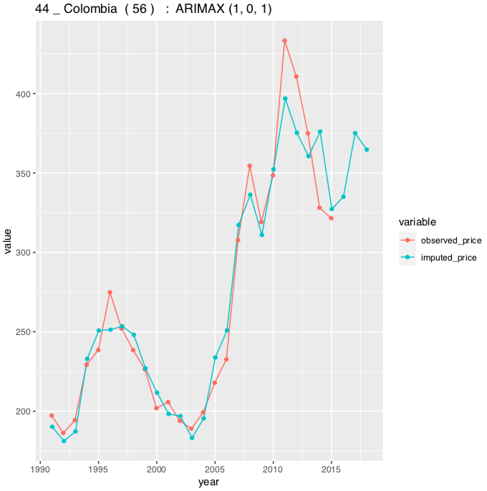
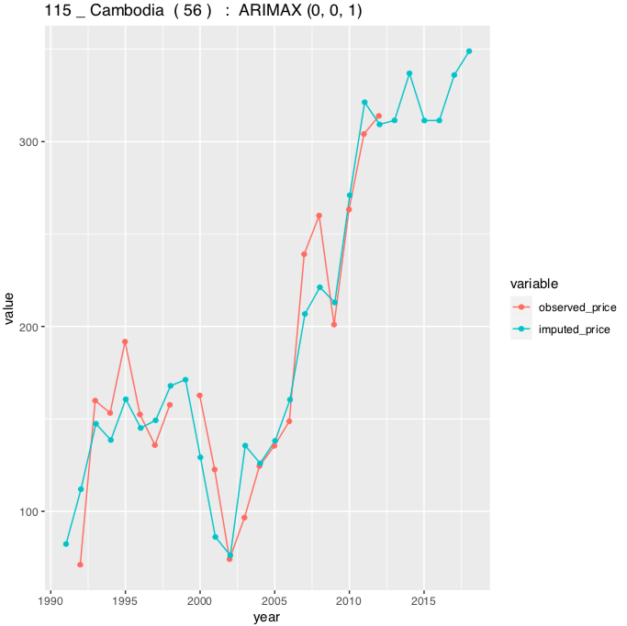
Producer Price Indexes – Revised methodology
Examples of ARIMAX estimation results
Cropcode 56: Maize - Producer Price Observed VS Imputed
Exogenous regressors:
Value Added_AFF; Yields; Exports_VA_AFF ratio
Exogenous regressors:
Gross Fix Capital Formation_AFF ; Yields; Trade Openess Index_AFF;

Slide 18
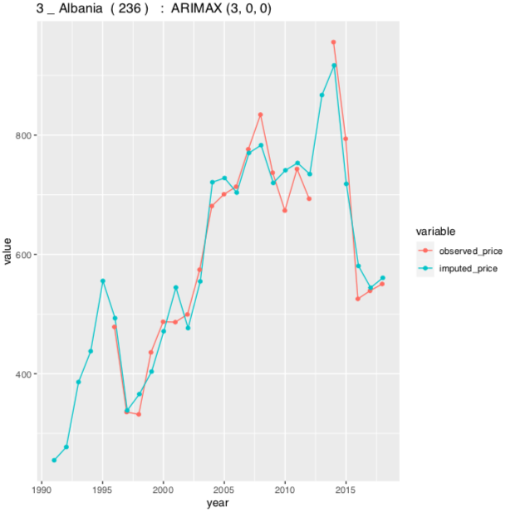
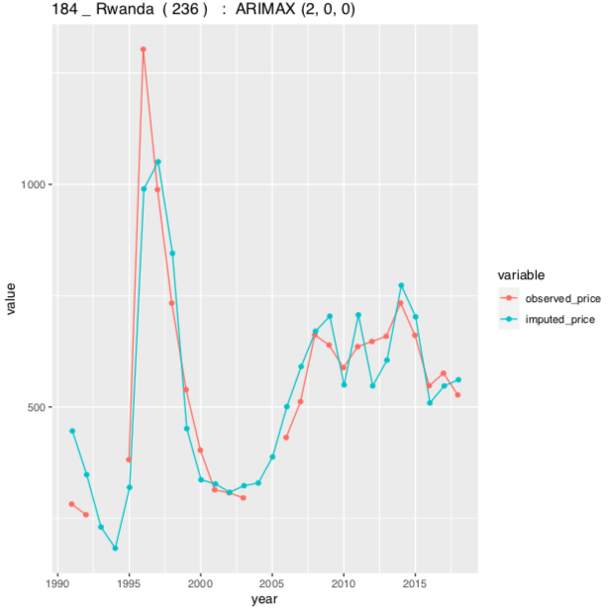
Producer Price Indexes – Revised methodology
Cropcode 236: Soybeans - Producer Price Observed VS Imputed
Exogenous regressors:
Gross Fix Capital Formation_AFF ; Yields; Trade Openess Index_AFF; Exports_VA_AFF ratio
Exogenous regressors:
pcGDP; Yields; Trade Openess Index_AFF

Slide 19
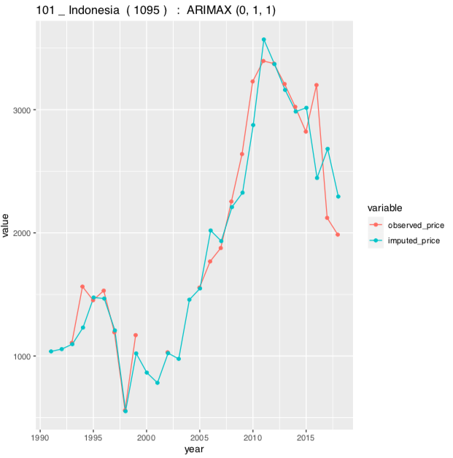
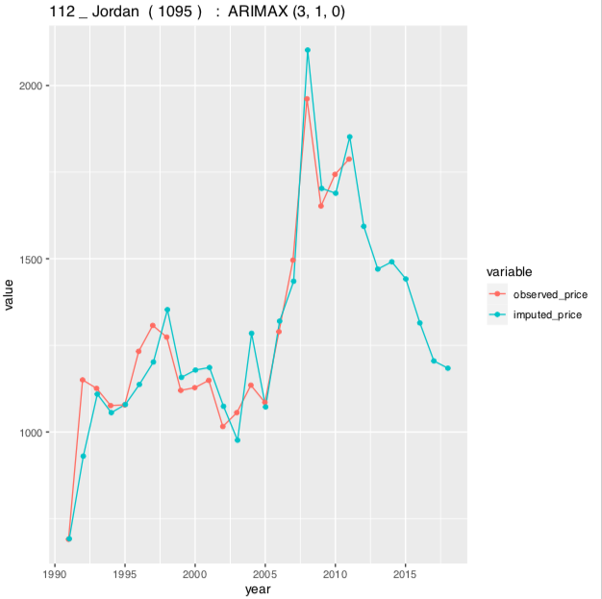
Producer Price Indexes – Revised methodology
Cropcode 1095: Meat, live weight chicken- Producer Price Observed VS Imputed
Exogenous regressors:
Gross Fix Capital Formation_AFF ; Trade Openess Index_AFF
Exogenous regressors:
pcGDP; Exports_TOI_AFF ratio

Slide 20
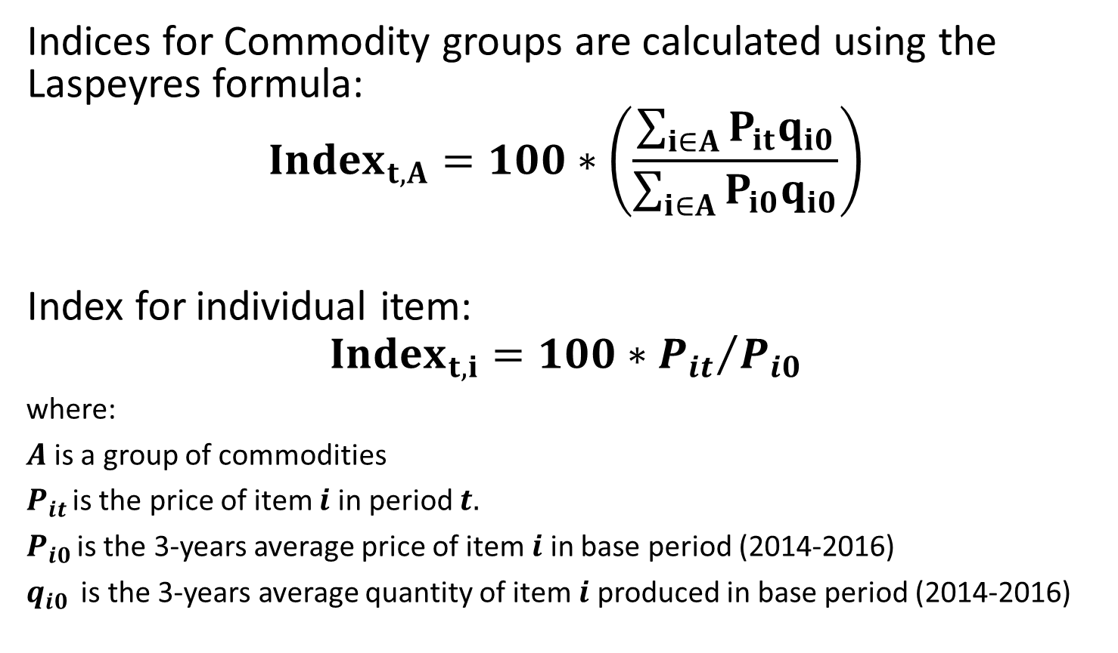
Producer Price Indexes – Revised methodology
Approach for PPI
Indices for Commodity groups are calculated using the Laspeyres formula:
$${Index}_{t,A}=100∗\left(\frac{\sum_{i∈A}{P_{it}q_{i0}}}{\sum_{i∈A}{P_{i0}q_{i0}}}\right)$$
Index for individual item:
$${Index}_{t,i}=100∗{P_{it}}/{P_{i0}}$$
where:
$A$is a group of commodities
$P_{it }$is the price of item $i$ in period $t.$
$P_{i0 }$is the 3-years average price of item $i$ in base period (2014-2016)
$q_{i0 }$ is the 3-years average quantity of item $i$ produced in base period (2014-2016)

Slide 21
Producer Price Indexes – Revised methodology
New methodology for forecasting PPI
Application of
Exponential smoothing as specified by Holt and Winters for non-seasonal series;
Based on an iterative process of moving average computation elaborated through a linear regression;
STATA provides a routine with flexibility in the specification of the model parameters for the optimization process (based on gof criteria) ;
After a validation process, we selected a couple of parameters favouring the link of the intercept to the last available value and a trend representing the pattern of the last few years of the price series

Slide 22
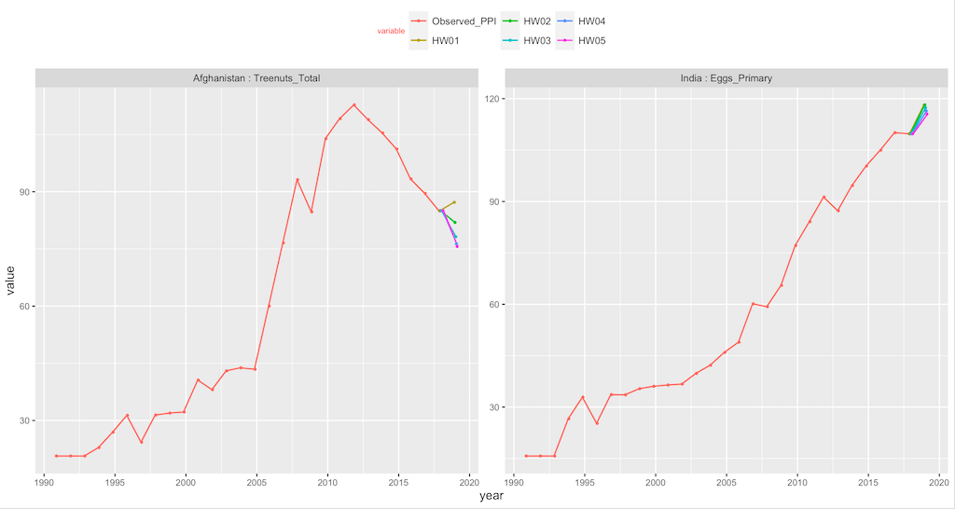
Producer Price Indexes – Revised methodology
Example of HW forecasting results

Slide 23
Producer Price Indexes – Revised methodology
PPI variation for aggregated items
Compound Annual Growth Rate
2010-2019 and 2015-2019

Slide 24
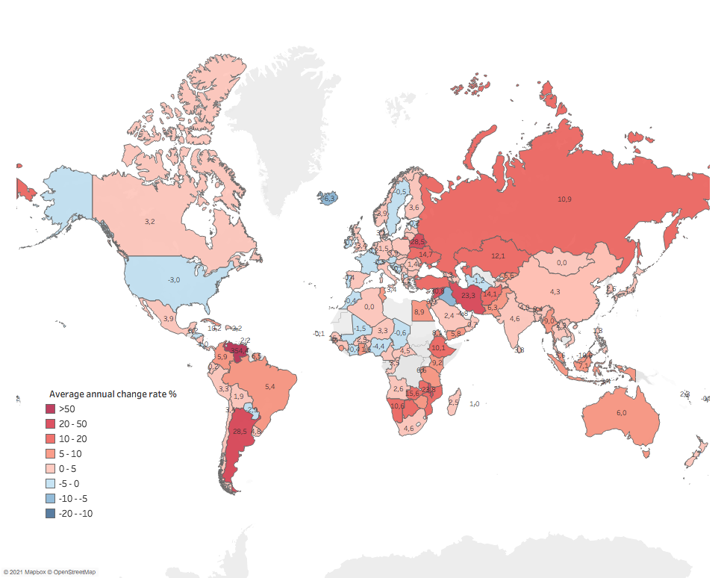
Producer Price Indexes – Revised methodology
Average Annual % change 2010-2019 - Cereals

Slide 25
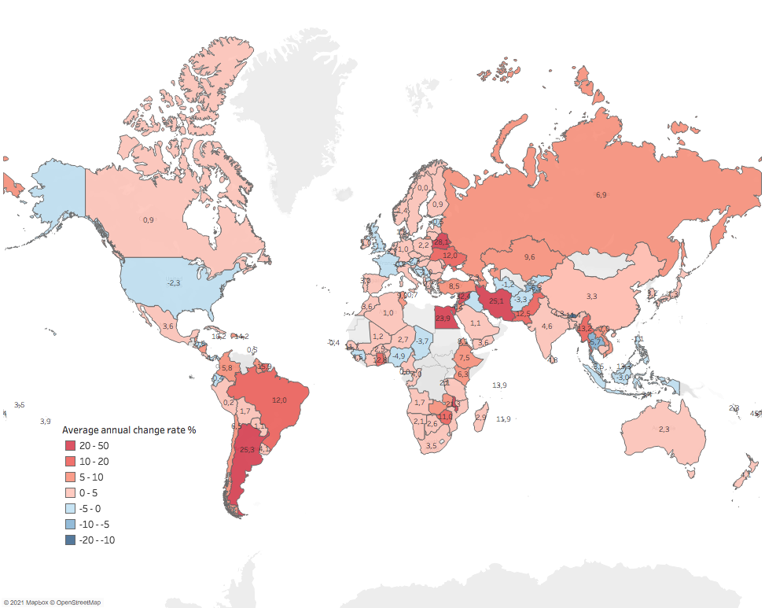
Producer Price Indexes – Revised methodology
Average Annual % change 2010-2019 - Oilcrops

Slide 26
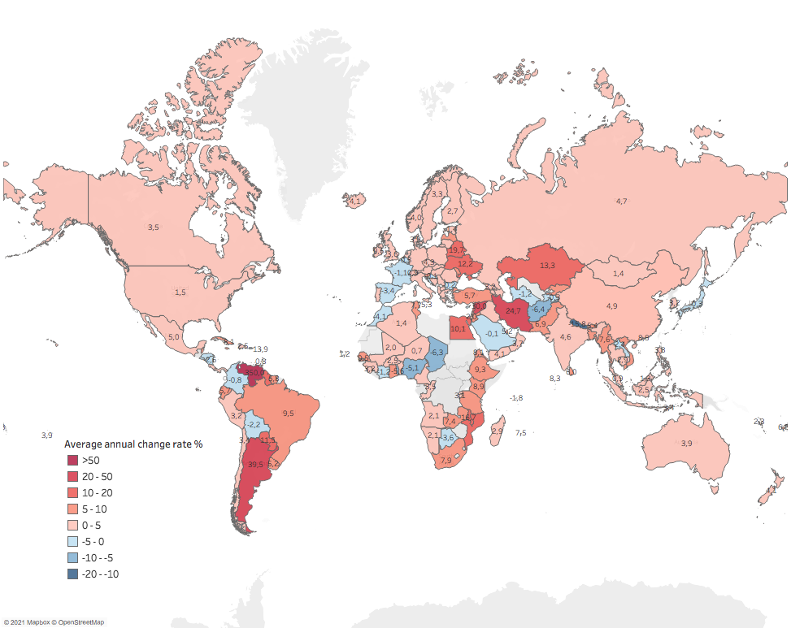
Producer Price Indexes – Revised methodology
Average Annual % change 2010-2019 – Vegetables&Melons

Slide 27
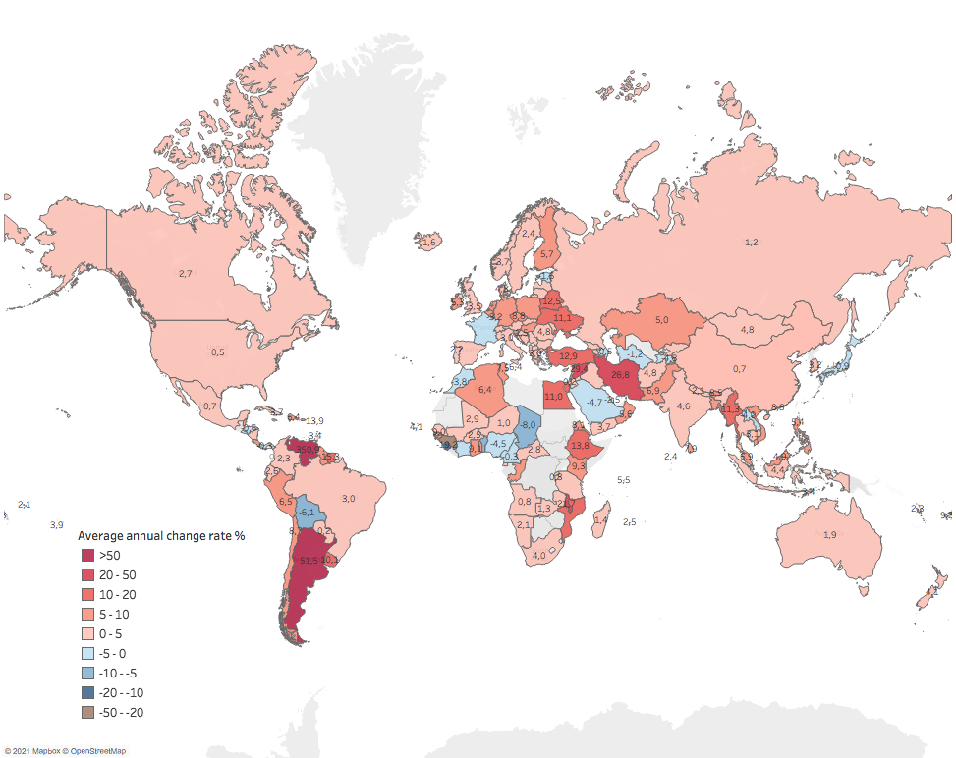
Producer Price Indexes – Revised methodology
Average Annual % change 2010-2019 – Roots&Tubers

Slide 28
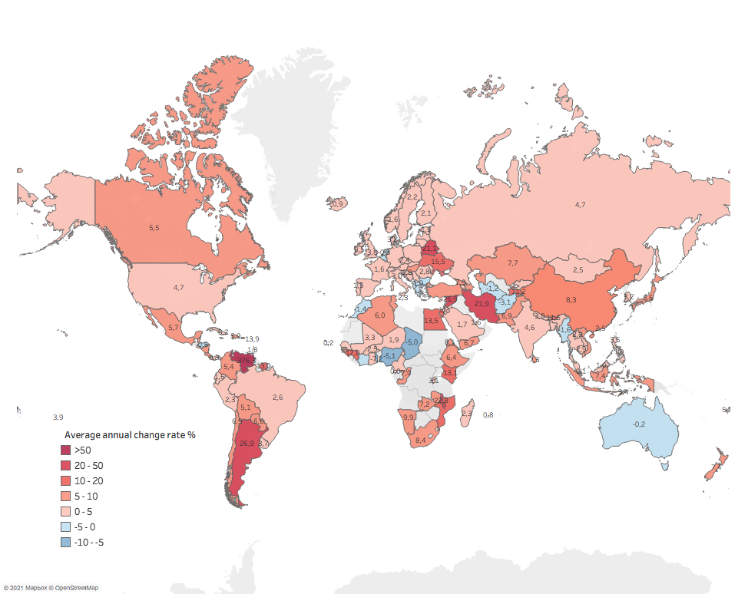
Producer Price Indexes – Revised methodology
Average Annual % change 2010-2019 - Meat

Slide 29
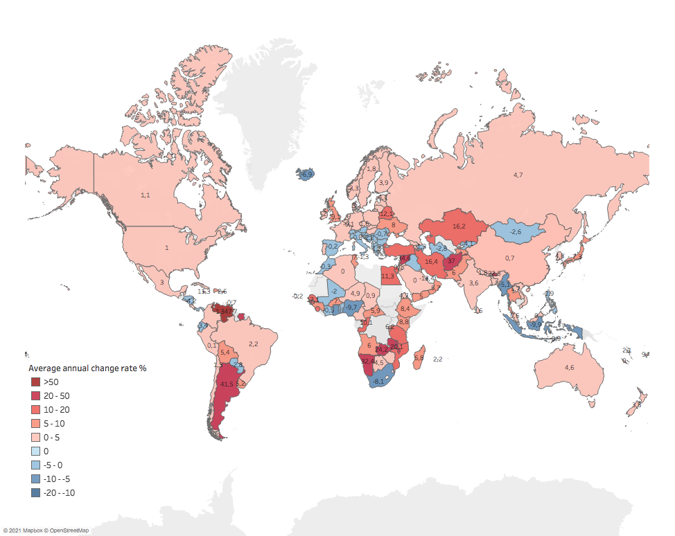
Producer Price Indexes – Revised methodology
Average Annual % change 2015-2019 - Cereals

Slide 30
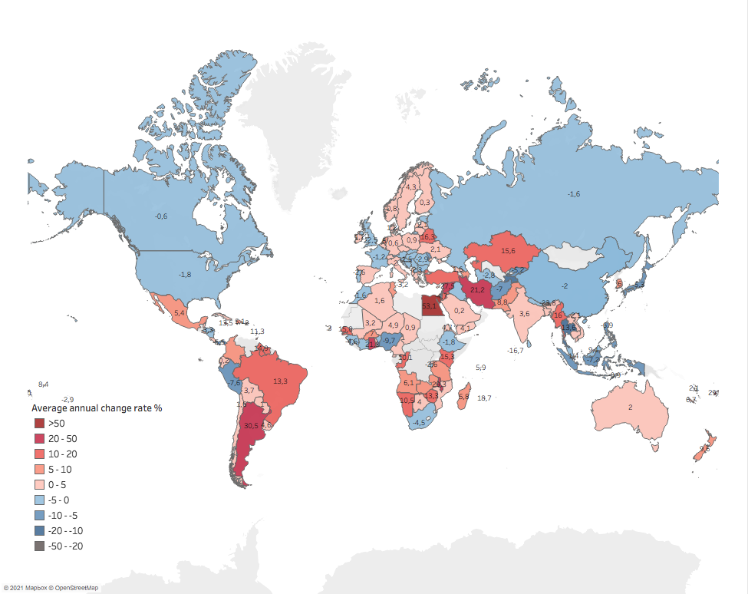
Producer Price Indexes – Revised methodology
Average Annual % change 2015-2019 - Oilcrops

Slide 31
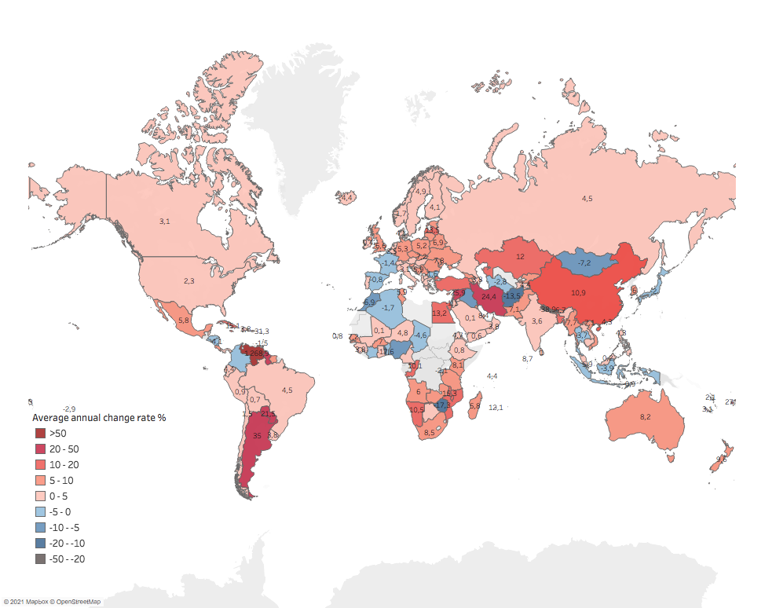
Producer Price Indexes – Revised methodology
Average Annual % change 2015-2019 - Vegetables&Melons

Slide 32
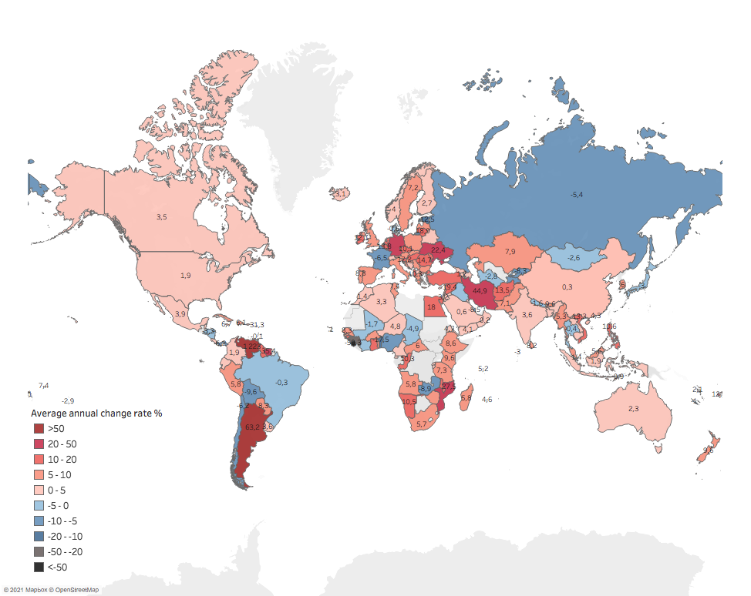
Producer Price Indexes – Revised methodology
Average Annual % change 2015-2019 – Roots&Tubers

Slide 33
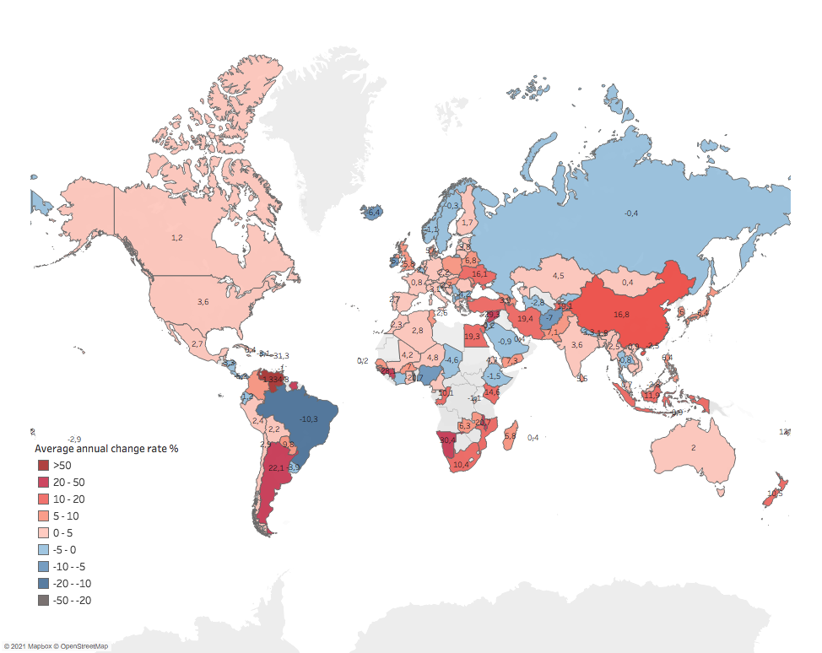
Producer Price Indexes – Revised methodology
Average Annual % change 2015-2019 - Meat

Slide 34
Producer Price Indexes – Revised methodology
Possible further improvement
More work on imputable gaps
Cross-check production data with missing price series, to identify potentially existing producer prices
Further collaboration and cross-check with Commodity specialists in EST
Further exanding the application of ARIMAX and Holt-Winters approaches
Testing the possibility of applying Panel-Cointegration approach

Slide 35
Producer Price Indexes – Revised methodology
Thank you!

